Slide 1
Decorator Pattern Example

Slide 2
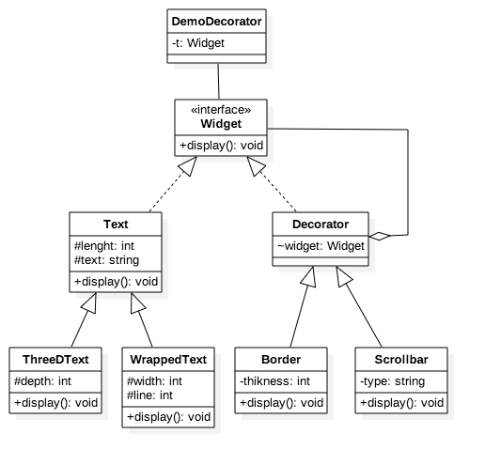
Let's define a set of interface and classes that can be used to develop an application that uses components such as text that can be furnished with additional features (decorators) such as border, scrollbar, or more as needed.

Slide 3
What About Using Inheritance
One possible solution is to use inheritance only to create all possible options of windows such as:
Window
Window with border
Window with vertical scrollbar
Window with horizontal scrollbar
Window with vertical and horizontal scrollbar
Window with vertical and horizontal scrollbar and board
Many more …
But the problem with this solution is that:
it does not allow the client to select any option that he desires. For example, you can not have Window with vertical scrollbar and border. You must develop another class for this purpose

Slide 4
Step 1: Definition of a Component
public interface Widget
{
void display();
}

Slide 5
Step 2: Defining an Abstract Decorator
abstract class Decorator implements Widget
{
Widget widget;
public Decorator(Widget w)
{
widget = w;
}
}

Slide 6
Step 3: Defining a Concrete Decorator
Now Let's build a concrete Decorator
public class Border extends Decorator {
private int thickness;
public Border(Widget w, int thick) {
super(w);
thickness = thick;
}
@Override
public void display() {
widget.display();
System.out.print(". It's border thickness is: " + thickness);
}
}

Slide 7
Steps 4: Creating More Decorators
public class Scrollbar extends Decorator {
private String type;
public Scrollbar(Widget w, String st) {
super(w);
type = st;
}
@Override
public void display() {
widget.display();
System.out.print(". Its scrollbar type is: " + type );
}
}

Slide 8
Step 5: Let’s create one or more concrete Components
We start by a concrete component that creates some text on the screen:
class Text implements Widget {
protected int length;
String text;
public Text( String s) {
text = s;
length = text.length();
}
public void display() {
System.out.print("This is a plain text: " + text + ", and its length is: " + length);
}
}

Slide 9
Step 6: more components
public class WrappedText extends Text {
private int width, lines;
public WrappedText (String s, int w, int h) {
super(s);
width = w;
lines = length / width;
}
public void display() {
System.out.print("This is a wrapped Text: " + text + ", and its length is: "
+ length + " Its width is " + width + " and its height is: " + lines);
}
}
public class ThreeDText extends Text {
protected int depth;
public ThreeDText(String s, int d){
super(s); depth = d;
}
public void display() {
System.out.print("3-D text, " + length + "character long " + depth + "pixel depth");
}
}

Slide 10
public class DemoDecorator {
public static void main(String[] args) {
Widget t = new Text ("TXT");
t.display();
System.out.println();
t = new Border(t, 2);
t.display();
System.out.println();
t = new Scrollbar(t, "vertical");
t.display();
// ASSUME MORE CODE TO ADD MORE DECORATORS
}
}

Slide 11
Sample Output
This is a plain text: TXT, and its length is: 3
This is a plain text: TXT, and its length is: 3. It's border thickness is: 2
This is a plain text: TXT, and its length is: 3. It's border thickness is: 2. Its scrollbar type is: vertical

